Slide 1
Algorithms
Lecture 4
Recursive Time Complexity
Prantik Paul [PNP]
Lecturer
Department of Computer Science and Engineering
BRAC University

Slide 2
Solving Recurrences- Methods
Iteration Method or Substitution Method
Recursion Tree Method
Master Theorem

Slide 3
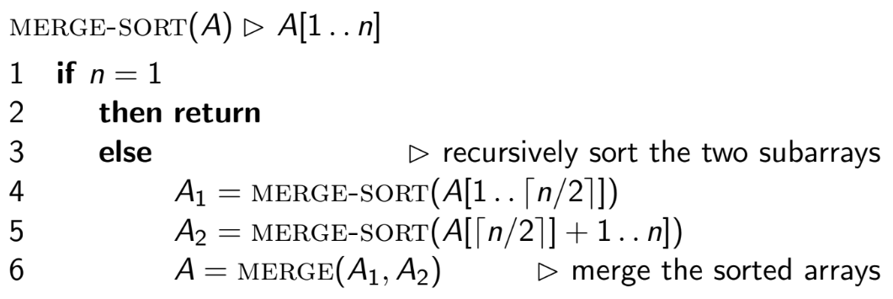
Merge Sort (Algorithm)

Slide 4
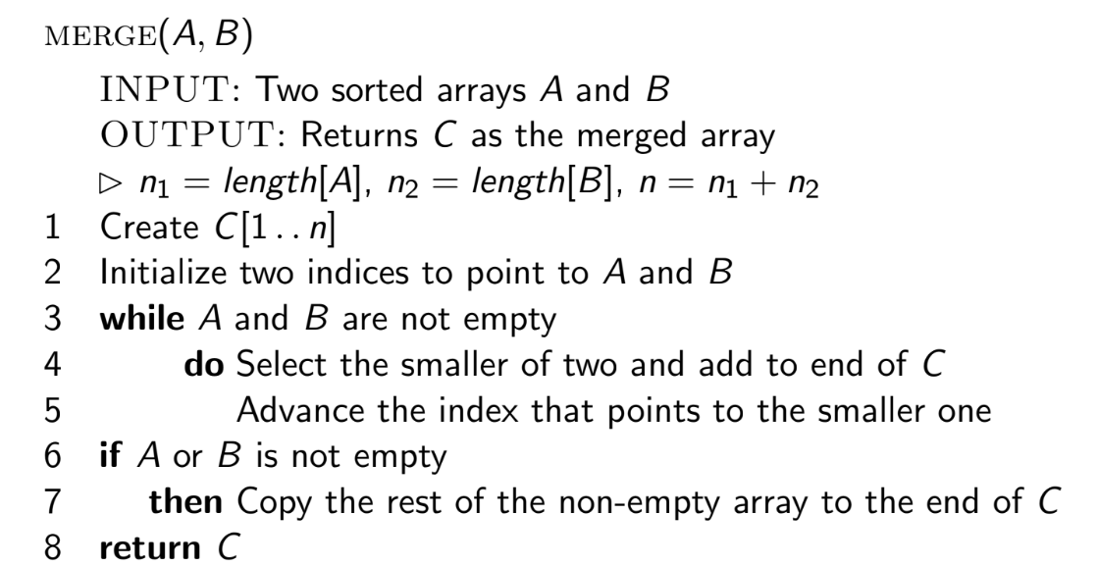
Merge (Algorithm)

Slide 5
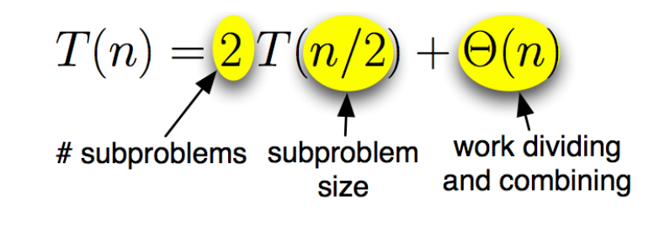
Merge Sort: Running Time

Slide 6
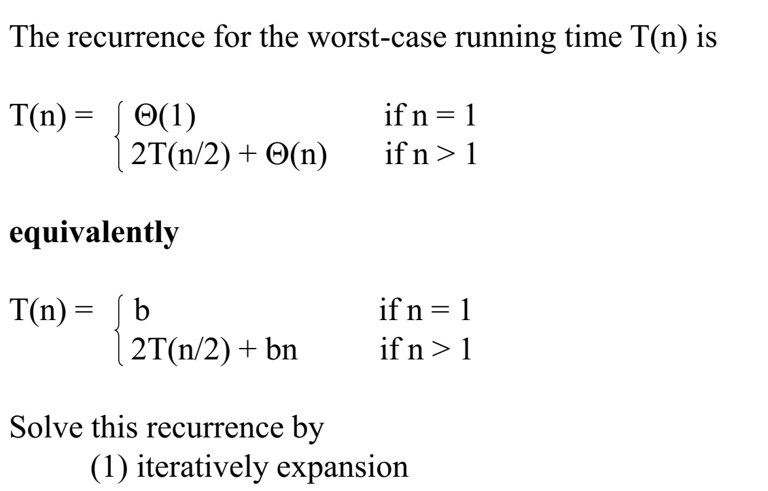
Merge Sort: Running Time

Slide 7
Iterative Approach
→ T(n) = T(n-1) + 1
= (T(n-2) + 1) + 1
= ((T(n-3) + 1) +1) + 1

Slide 8
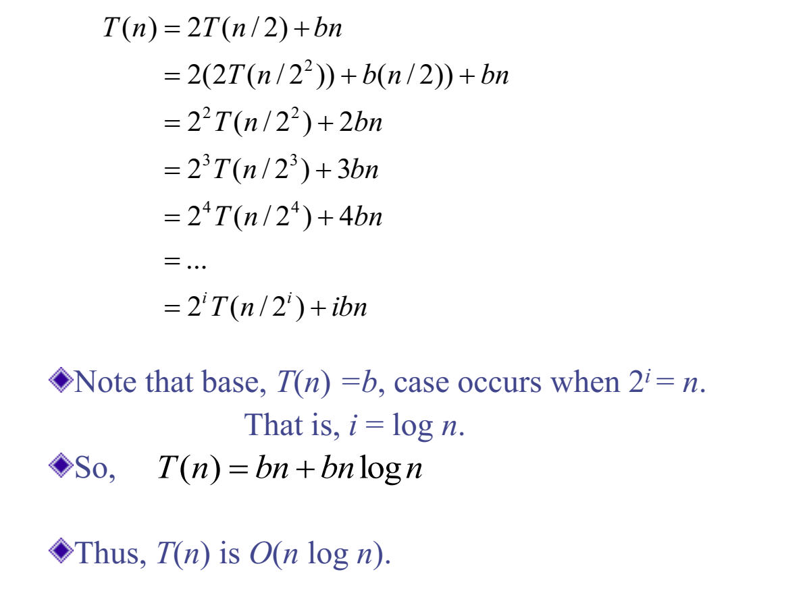
Merge Sort: Running Time
Refer to notes

Slide 9
Iteration Method
Try:
T(n) = 4T(n/2) + bn
T(n) = 3T(n/2) + bn

Slide 10
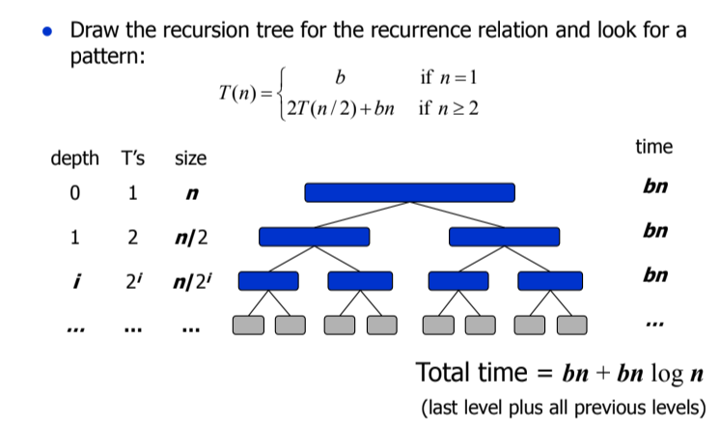
Recursion Tree Method

Slide 11
Recursion Tree Method
Try:
T(n) = T(n/3) + T(2n/3) + cn
T(n) = 3T(n/4) + cn²

Slide 12
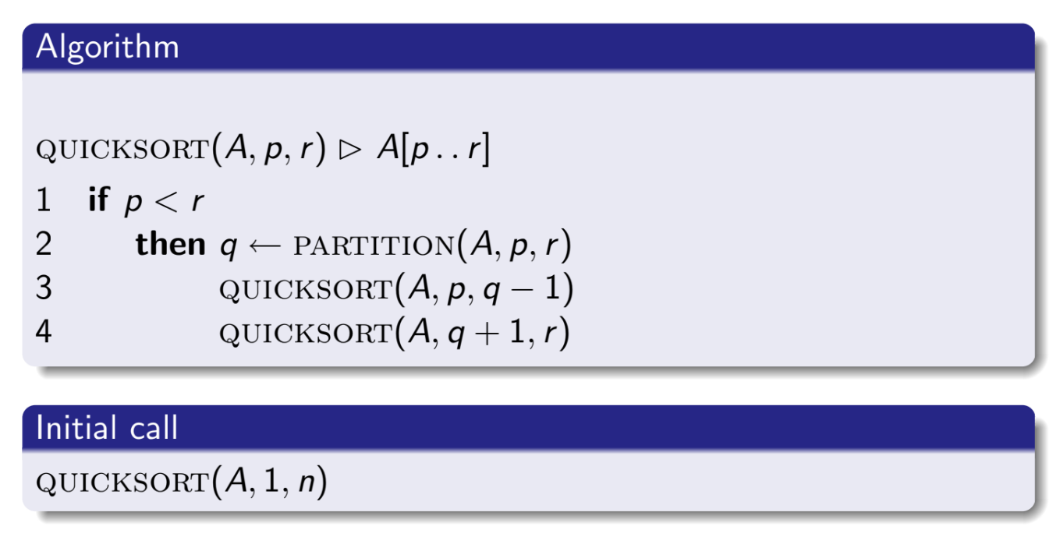
Quick Sort (Algorithm)

Slide 13
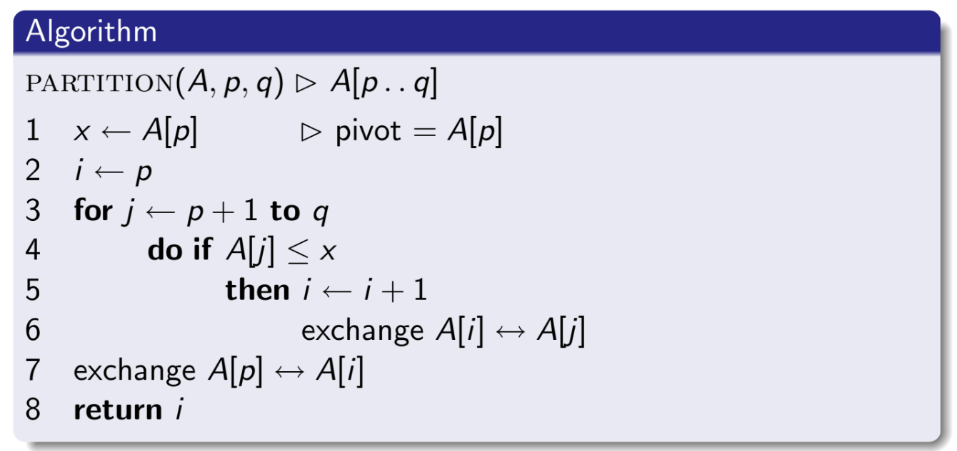
Partitioning (Algorithm)

Slide 14
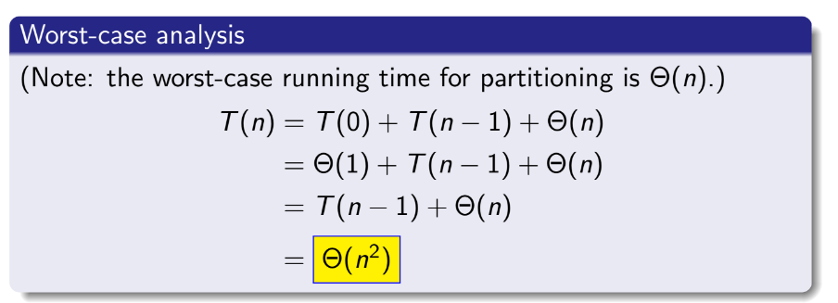
Quick Sort: Running Time

Slide 15
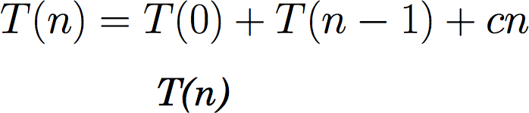
Quick Sort: Recursion Tree Worst Case

Slide 16
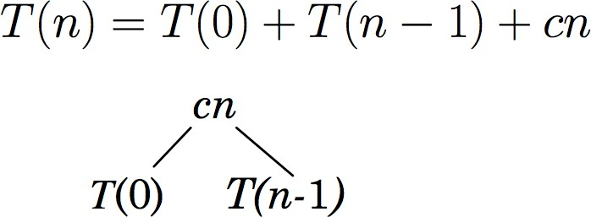
Quick Sort: Recursion Tree Worst Case

Slide 17
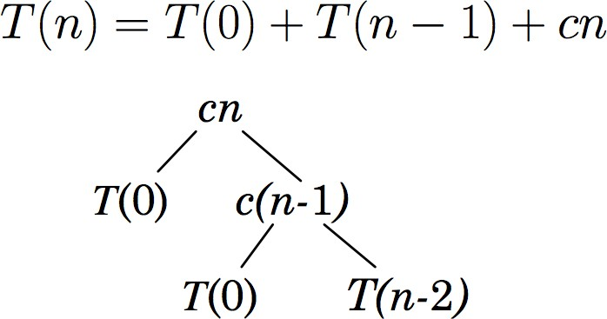
Quick Sort: Recursion Tree Worst Case

Slide 18
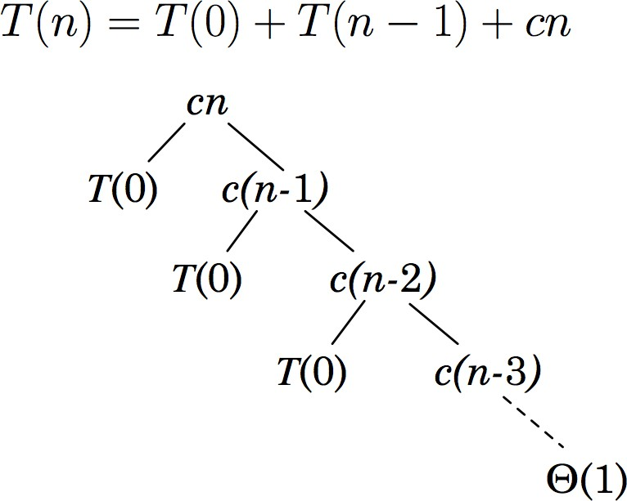
Quick Sort: Recursion Tree Worst Case

Slide 19
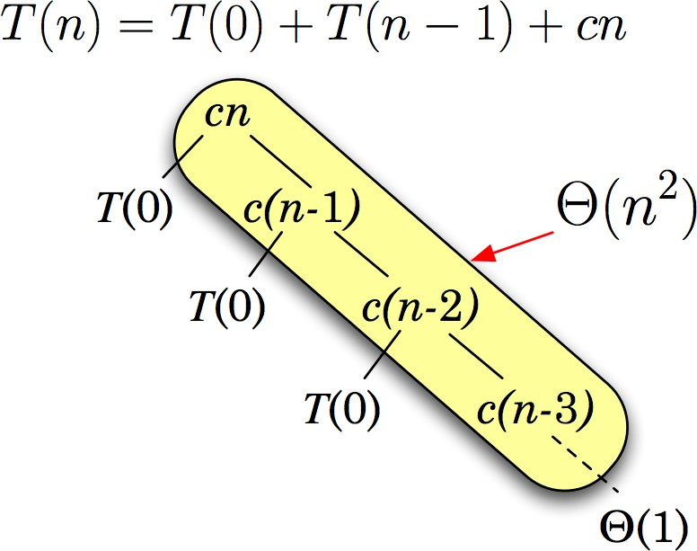
Quick Sort: Recursion Tree Worst Case

Slide 20
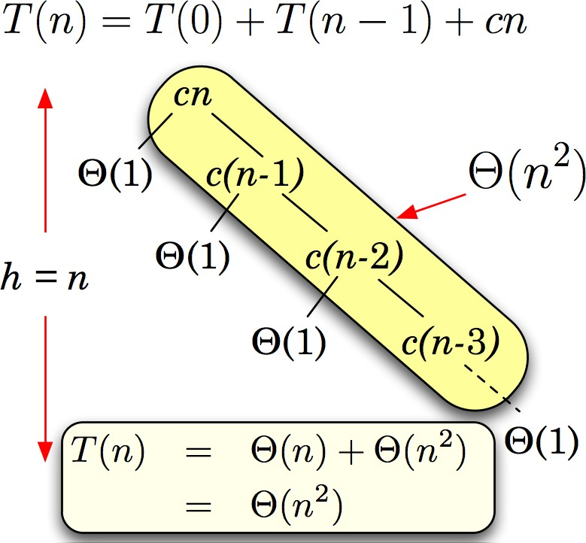
Quick Sort: Recursion Tree Worst Case

Slide 21
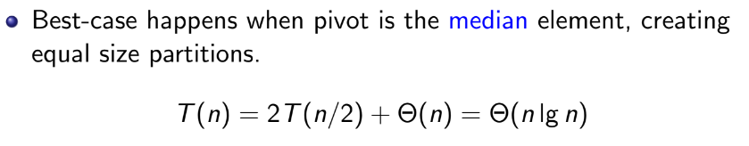
Quick Sort: Running Time (Best Case)

Slide 22
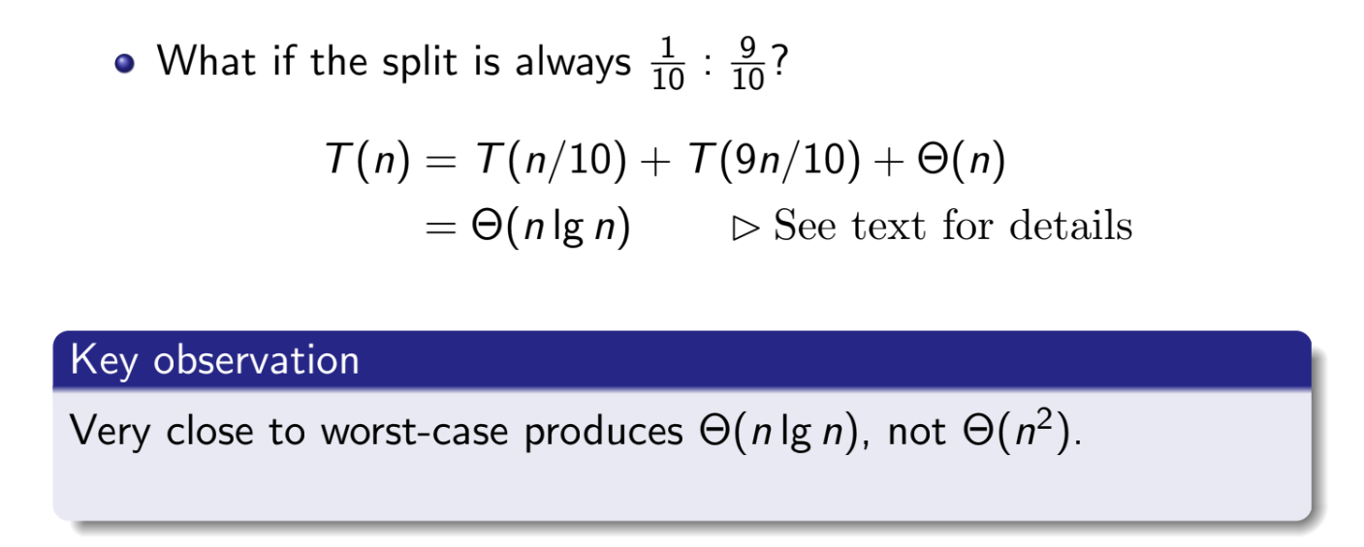
Quick Sort: Running Time (Almost Worst Case)
Refer to book

Slide 23


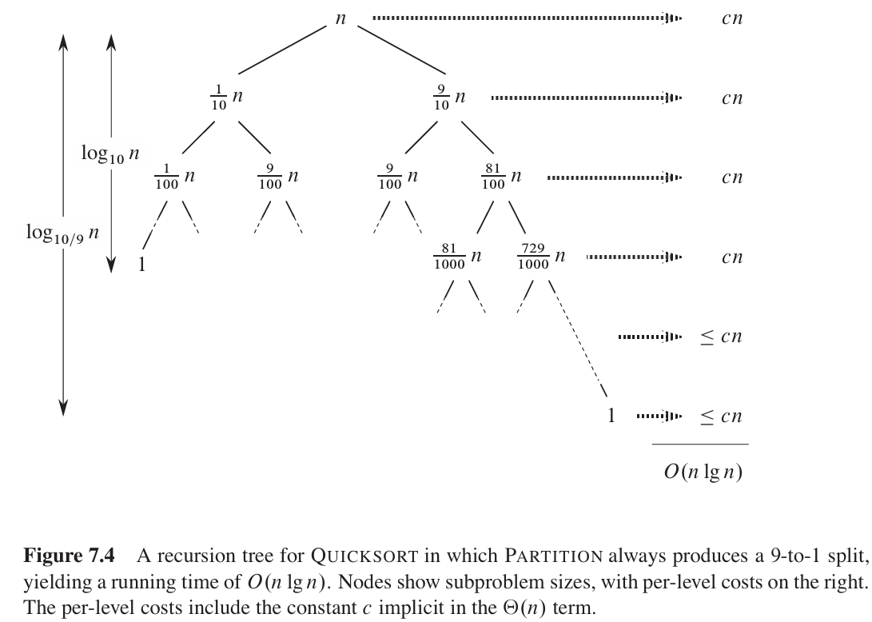

Quick Sort: Running Time (Almost Worst Case)
<= cn as some of the branch has started returning

Slide 24
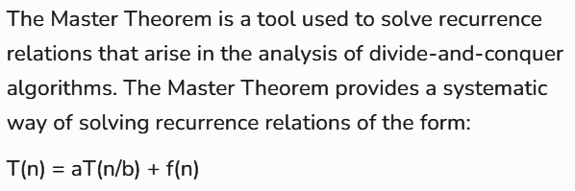
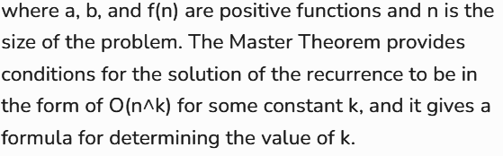
Master Theorem

Slide 25
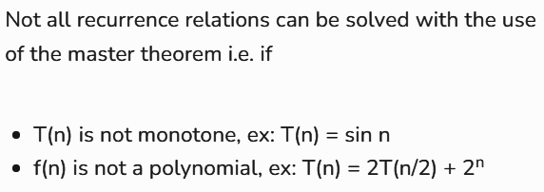
Master Theorem

Slide 26
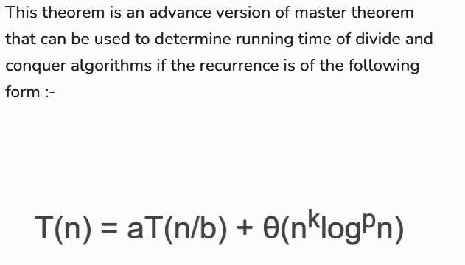
Master Theorem

Slide 27
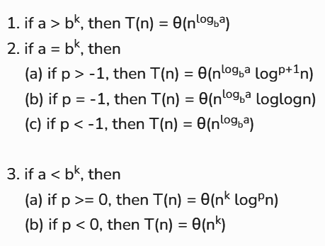
Master Theorem

Slide 28
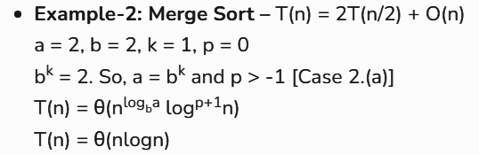
Master Theorem

Slide 29
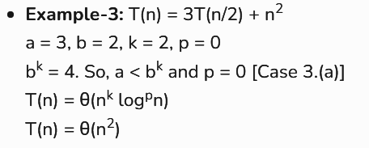
Master Theorem

Slide 30
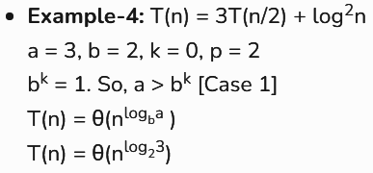
Master Theorem

Slide 31
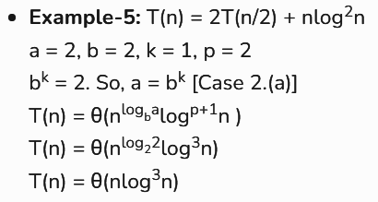
Master Theorem

Slide 32
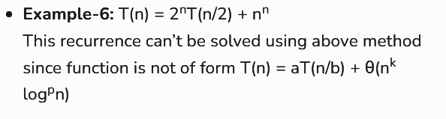
Master Theorem

Slide 33

Master Theorem
Not solvable by general theorem, but solvable by advanced version

Slide 34
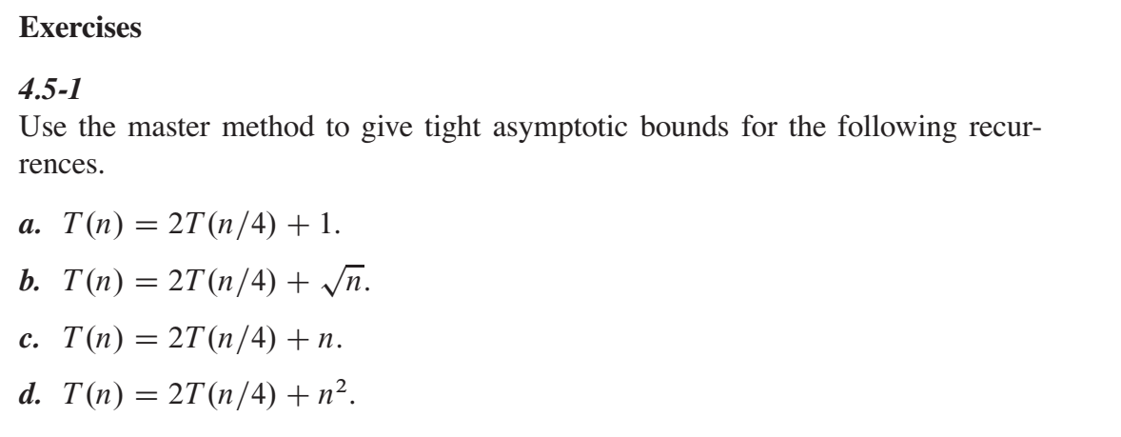
Master Theorem

Slide 35
Resources
CLRS Book:
Chapter 2.3.2 - Merge Sort Analysis
Chapter 4.4 - Recursion Tree Method
Chapter 4.5 - Master Method
Chapter 7.4 - Quicksort Analysis
Recursive Time Complexity Notes
Master Theorem Explanation

